Slide 1
Network Proposal
Cadets William Born and Kayleigh Stallings

Slide 2
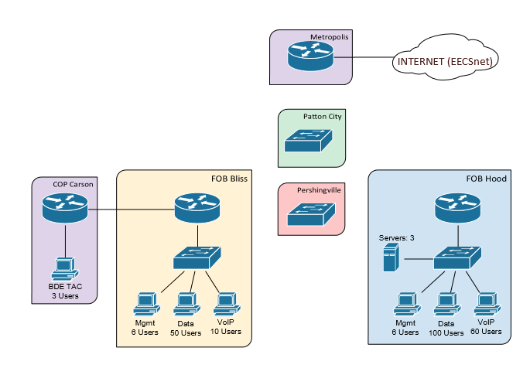
Network Overview

Slide 3
Requirements
All users need internet access
If a link is cut between FOB Bliss and Pershingvill, FOB Bliss should sill have access to all other sites
BDE TAC wants Wi-Fi
Internal users have access to 2 web servers and a DNS server
Only appropriate traffic should be sent to each server
No users from the outside should be able to access the servers or ping the network

Slide 4
Constraints
IP Space= 10.64.62.0/24
Metropolis router IP = 10.64.0.62/24
OSPF must be used between main sites and COP

Slide 5
Network Diagram
Fa0/1
Fa0/0
Fa0/0.100: 10.64.64.10
Fa0/0.200: 10.64.64.20
Fa0/0.300: 10.64.64.30
Fa0/0.500: 10.64.64.50
Fa0/1 10.64.0.64
Default Gateway: 10.64.0.64
Fa0/0: 10.64.64.2/24
Fa1/0: 10.64.64.6/24
Fa1/1: 192.168.74.139/31
Fa0/1.200:192.168.74.127/25
Fa0/1.500:192.168.74.126/25
VLAN 200
VLAN 500
IP:10.64.64.4/24
Fa0/0: 192.168.64.138/31
Fa0/1:192.168.74.133/29
VLAN 400
Fa0/0
Fa0/0: 10.64.64.1/24
Fa0/1.100:192.168.64.251/24
Fa0/1.500:192.168.64.252/24
VLAN 100
VLAN 500
Fa0/0
Fa1/1
Fa0/0
Fa1/0
Fa0/1
Fa0/1
Fa0/1
IP:10.64.64.3/24
IP:192.168.74.129-132/29
VLAN 300
Default Gateway:
192.168.74.133
IP1:192.168.64.3/24
IP2:192.168.64.4/24
IP3:192.168.64.5/24
VLAN 100
Default Gateway:
192.168.64.251
IP:192.168.64.2/24
IP:192.168.64.6-65/24
VLAN 100
Default Gateway:
192.168.64.251
IP:192.168.74.61-67/25
VLAN 500
Default Gateway:
192.168.74.126
IP:192.168.64.166-.171/24
VLAN 500
Default Gateway:
192.168.64.252
IP:192.168.74.11-60/25
VLAN 200
Default Gateway:
192.168.74.127
IP:192.168.74.1-10/25
VLAN 200
Default Gateway:
192.168.74.127
IP:192.168.64.66-165/24
VLAN 100
Default Gateway:192.168.64.251

Slide 6
Subnetting Chart
Private Addresses
Location | Network | Subnet Mask | Usable Range | Broadcast
FOB HOOD | 192.168.64.0 | 255.255.255.0 | 192.168.64.1-.255 | 192.168.64.256
FOB BLISS | 192.168.74.0 | 255.255.255.128 | 192.168.74.1-.126 | 192.168.74.127
COP CARSON | 192.168.74.128 | 255.255.255.248 | 192.168.74.129-.135 | 192.168.74.136
Router to Router | 192.168.74.137 | 255.255.255.252 | 192.168.74.138-.139 | 192.168.74.140
Public Addresses
Location | Network
FOB HOOD | 10.64.64.1
FOB BLISS | 10.64.64.2 10.64.64.6
Location | Network
Pershingville | 10.64.64.3
Patton | 10.64.64.4
Metropolis | 10.64.64.5
Network will utilize PAT to save the limited IP space

Slide 7
VLAN Configuration
VLAN Number | VLAN Name | IP on Metropolis
500 | Management | 10.64.64.50
100 | FOB HOOD | 10.64.64.10
200 | FOB BLISS | 10.64.64.20
300 | COP CARSON | 10.64.64.30

Slide 8
Routing

Slide 9
ACLS, NAT and wireless

